Slide 1
Fourier Transform
Part - 1

Slide 2
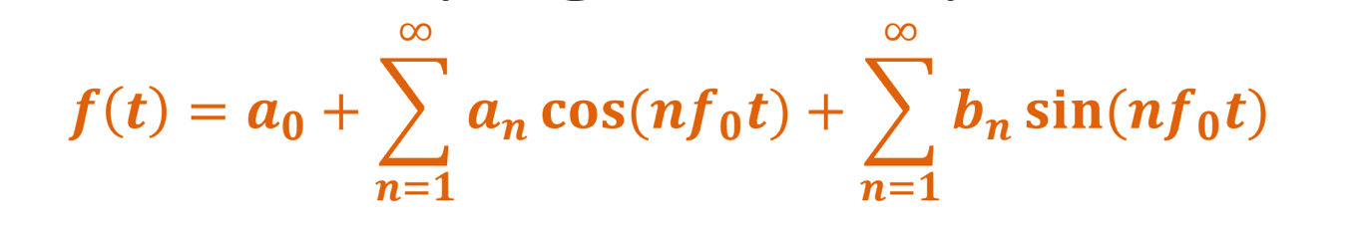
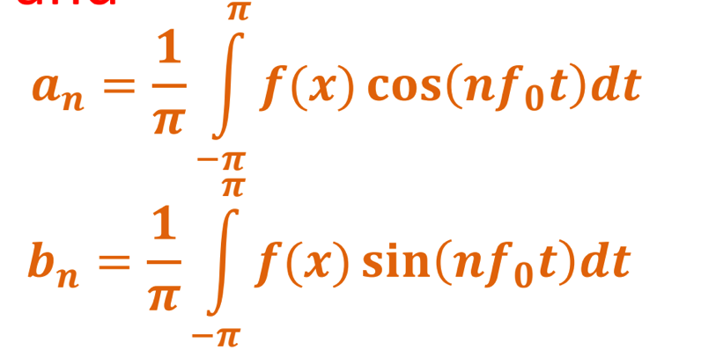
Fourier Series Theorem
Any periodic function can be expressed as a weighted sum (infinite) of sine and cosine functions of varying frequency:
where
f₀ is called the “fundamental frequency” and

Slide 3
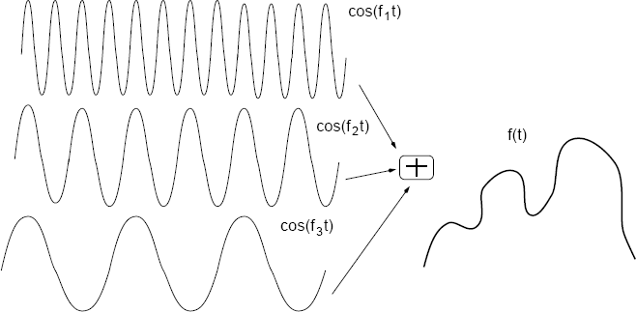
Fourier Series
One of the Fundamental Secrets of the Universe
All waveforms, no matter what you scribble or observe in the universe, are actually just the sum of simple sinusoids of different frequencies.

Slide 4
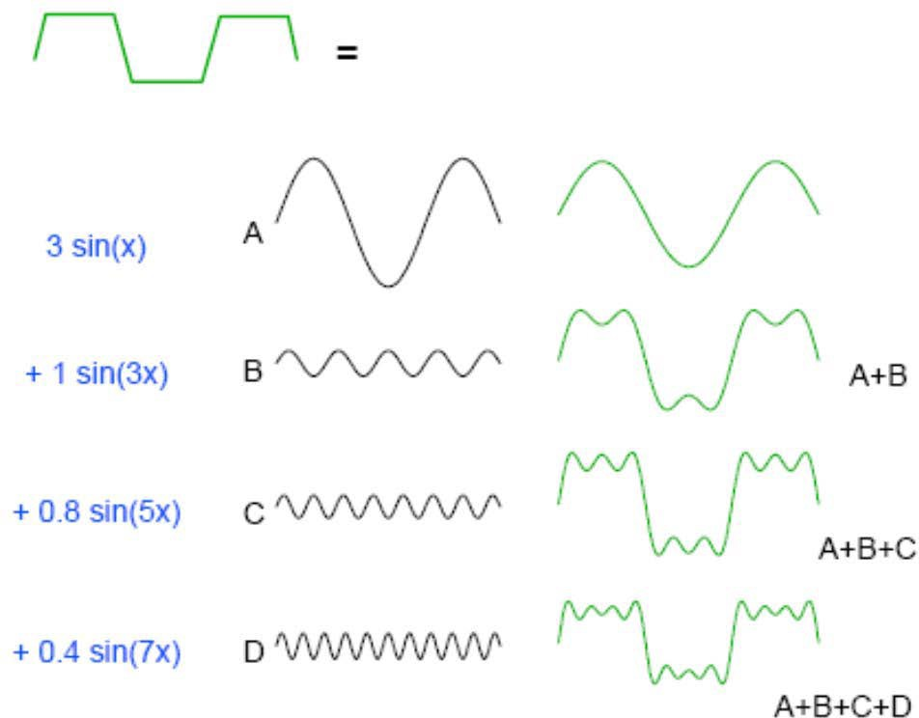
Fourier Series
Image source: http://dept.me.umn.edu/courses/me5286/vision/Notes/2015/ME5286-Lecture5.pdf

Slide 5
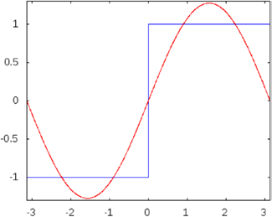
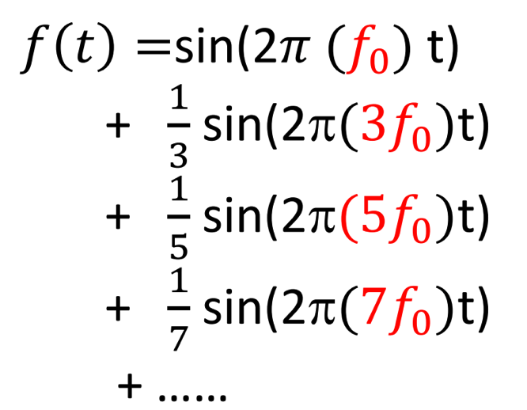
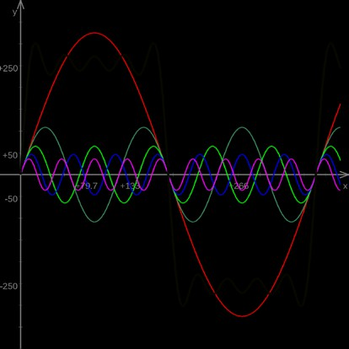
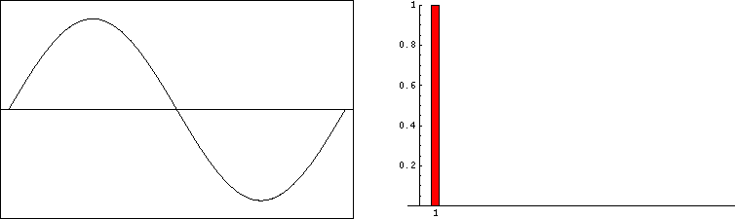
Time Vs. Frequency Domain
Square wave (blue curve)
Time (spatial) domain
Fourier (frequency) domain
Fourier composition of a square wave
Top Image: Fourier composition of a square wave. (Courtesy of Dr. Dan Russell, Grad. Prog. Acoustics, Penn State). Taken from https://www.linkedin.com/feed/

Slide 6
What is a Fourier Transform?
The Fourier transform states that a non-periodic function whose area under the curve is finite can also be represented as the weighted sum (infinite) of sine and cosine functions of varying frequency.
It represents a function with the help of sine and cosine
functions
real valued in our case
Could be a complex too
Note: we’ll use following terms interchangeably
Function
Signal
Waveform

Slide 7
What is a Fourier Transform?
It is a tool that breaks a waveform (a function or signal) into an alternate representation
Uses sine and cosine functions defined in terms of frequencies
High frequency components
Low frequency components

Slide 8
Fourier Transform & Image
Images can be considered non – periodic functions.
So Fourier transform can be used to convert images into frequency domain.

Slide 9
Fourier Transform & Image
An image can be represented in two domains
Spatial domain (Real space)
Frequency domain (Fourier space)
Image processing methods can be broadly divided into two categories:
Spatial domain (Real space) methods
Frequency domain (Fourier space) methods

Slide 10
Fourier Transform & Image
Why do we need to convert Fourier transform of an Image
Better analysis and interpretation
Some of the operations can be efficiently performed in Fourier domain

Slide 11
Fourier Transform & Image
Spatial domain (Real space) methods
work by directly processing input pixel array
Frequency domain (Fourier space) methods
first perform Fourier transform of the input data to get a new representation
new data is then processed, and finally
inverse Fourier transform is performed on the resulting data to give the final output image

Slide 12
Fourier Transform & Inverse Fourier Transform
Fourier Transform:
Tool which converts a spatial (real space) description of an image into one in terms of its frequency components
Spatial domain to Frequency domain
Inverse Fourier Transform:
Tool which turns a Fourier space description of an image back into real space
Frequency domain to Spatial domain

Slide 13
Significance of Frequency
What is the significance of frequencies in an image?
High frequency
Low frequency

Slide 14

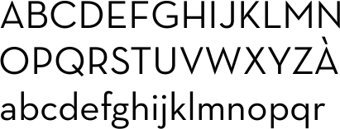
Significance of Frequency
High Frequency:
– If an image has large values at high frequency components then it means the data is changing rapidly on a short distance scale
– e.g., a page of text
Pixel
Intensity, I
Text image: data changes rapidly
Column index, x

Slide 15

Significance of Frequency
Low Frequency
If the image has large low frequency components then it means the large scale (slow varying) features of the picture are more prominent
e.g. a single fairly simple object which occupies most of the image
Pixel Intensity, I
Text image: data changes are slow
Column index, x

Slide 16
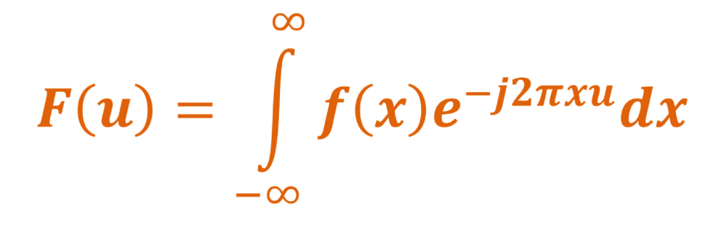
Fourier Transform: 1-D Case
1-D Case:
Consider a continuous function f(x) of a single variable x representing distance
The Fourier transform of function f(x) , denoted by F(u) where u represents spatial frequency, is defined by:

Slide 17
Fourier Transform: 1-D Case
Important point to note
in general F(u) will be a complex quantity even though the original data is purely real
Meaning of Complex Quantity:
The meaning of this is that, not only is the magnitude of each frequency present important, but that its phase relationship is too

Slide 18
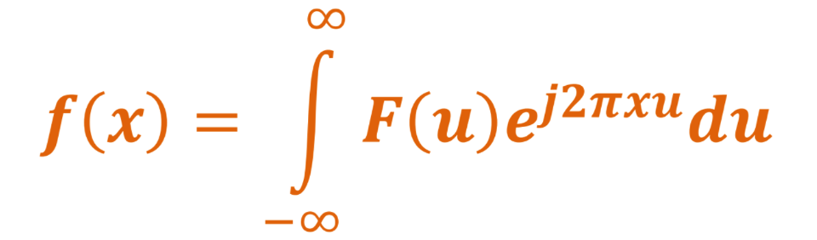
Fourier Transform: 1-D Case
Inverse Fourier Transform
– The inverse Fourier transform for obtaining f(x) from F(u) is given by:
This is quite similar to Fourier transform except that the exponential term has the opposite sign

Slide 19
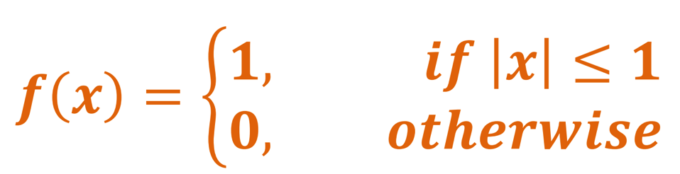
Fourier Transform: 1-D Case
Example 1:
– Consider function f(x) defined as below for Fourier transform computation
𝒇(𝒙)
𝟏
−𝟏
𝟎
𝟏
𝒙

Slide 20
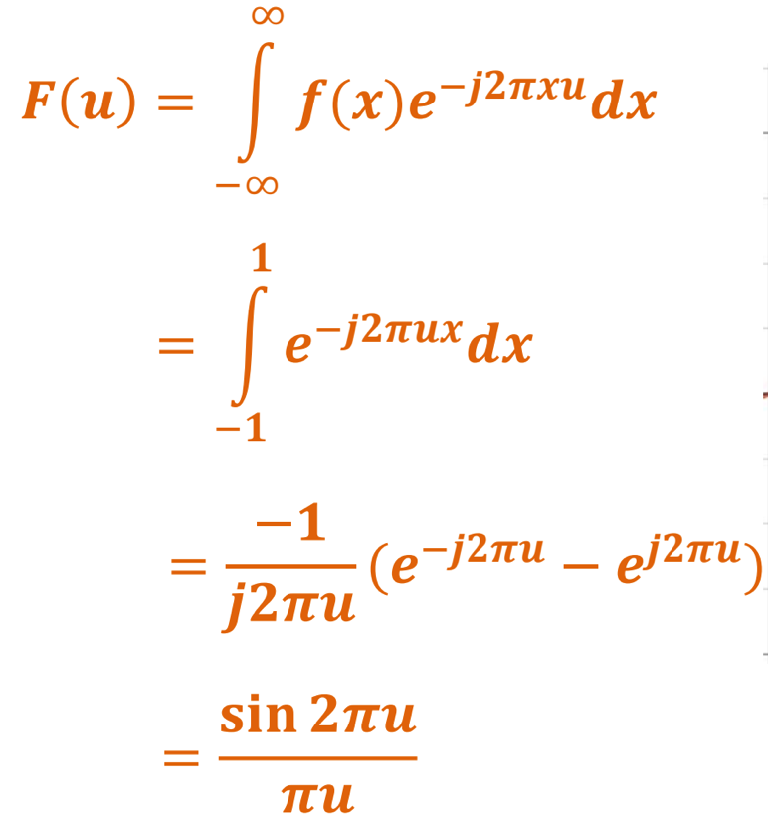
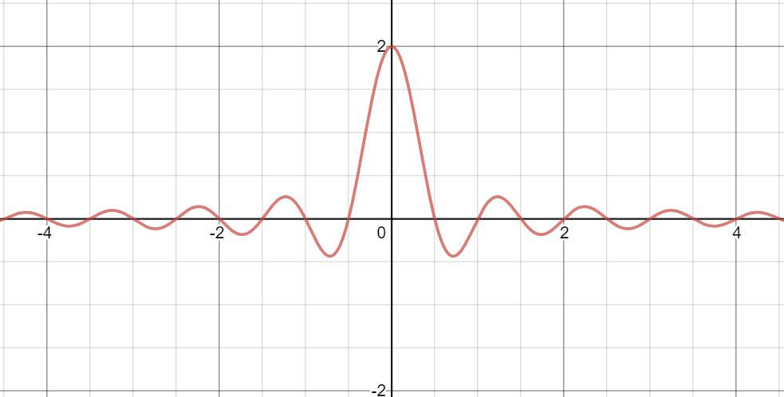
Fourier Transform: 1-D Case
F(u)
u
In this case F(u) is purely real, which is a consequence of the original data being symmetric in x
Sinc function
– This function is often referred to as the Sinc function

Slide 21
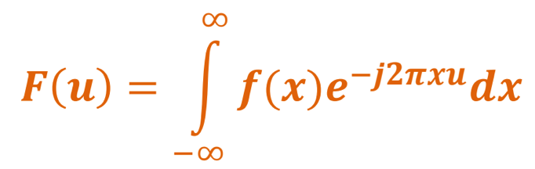
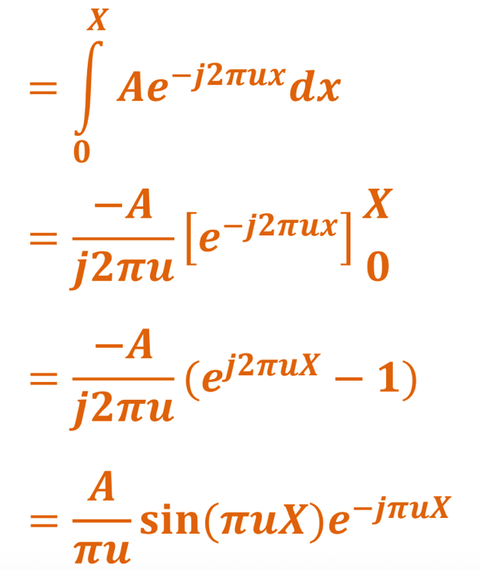
Fourier Transform: 1-D Case
Example 2:
– f(x) definition: from 0 to X, f(x) is A
𝒇(𝒙)
𝑨
𝟎
𝑿
𝒙
𝐜𝐬(𝝅𝒖𝑿)
= 𝑨𝑿
𝑭 𝒖
𝝅𝒖𝑿
𝑨𝑿
|𝑭 𝒖 |
−𝒋𝒋/𝒙𝒙
−𝟏/𝒙
^{𝟎} 𝟏/𝒙
𝒋/𝒙
𝒖

Slide 22
Magnitude and Phase
F (u) = R(u) + jI (u)
🡨 Euler's formula
𝑒^{𝑖𝜑} = cos 𝜑 + 𝑖 sin 𝜑
= F (u) e ^{jϕ (u )}
F(u) = R² (u) + I ² (u)
ϕ(u) = arctan ^{I (u)}
R(u)
|F(u)| is called the magnitude spectrum
φ(u) is called the phase spectrum (phase angle)

Slide 23
Magnitude and Phase
Power Spectrum or Spectral Density
P(u) = F(u) ² = R² (u) + I ² (u)
For display, we can use following formulation
D(u) = c log(1+ F (u) )

Slide 24
End

Slide 25
Fourier Transform
Part - 2

Slide 26
Quick Review of the Last Class
Fourier Series
Fourier Transform
Notion of (with respect to images)
Low frequency
High frequency
Fourier Transform: 2-D Case (Continuous)

Slide 27
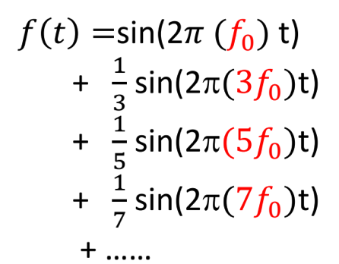
Time (Space) Domain Vs. Frequency Domain
Square wave (blue curve)
Time (spatial) domain
Fourier (frequency) domain
Fourier composition of a square wave
Top Image: Fourier composition of a square wave. (Courtesy of Dr. Dan Russell, Grad. Prog. Acoustics, Penn State). Taken from https://www.linkedin.com/feed/

Slide 28
Agenda for Today’s Class
Fourier Transform: 2-D Case (Continuous)
Discrete Fourier Transform: 1-D Case
Discrete Fourier Transform: 2-D Case

Slide 29
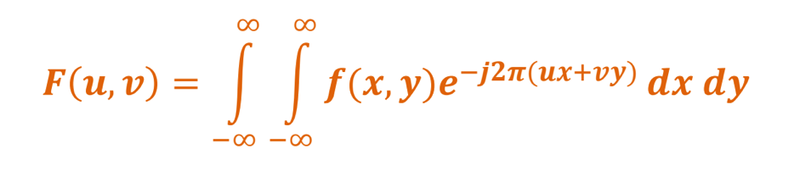
Fourier Transform: 2-D Case
Fourier Transform:
–If f(x,y) is a 2D function, its Fourier transform is given by:
f(x, y) is a 2D function and, for example, it can be the brightness in an image

Slide 30
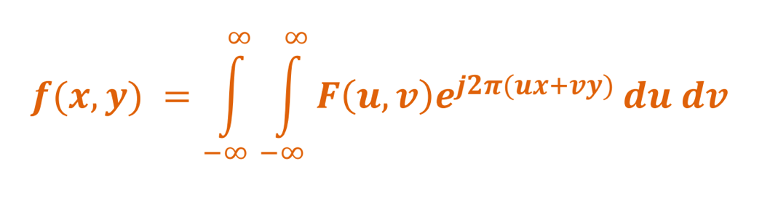
Fourier Transform: 2-D Case
Inverse Fourier transform
–It is given as follows

Slide 31
Discrete Fourier Transform

Slide 32
Discrete Fourier Transform: 1-D Case
Images are discrete sequence of numbers
Thus, we need a discrete formulation of the Fourier transform
DFT
Input: takes regularly spaced data values,
Output: it returns the value of the Fourier transform (a set of values in frequency space which are equally spaced)
Replacing the integration by summation quite naturally gives the discrete Fourier transform (DFT)

Slide 33
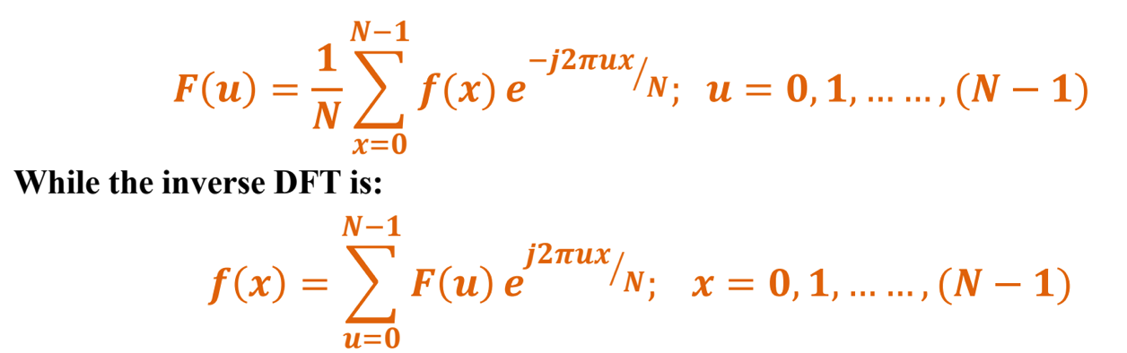
Discrete Fourier Transform: 1-D Case
Assume that x takes values from 0 to N-1
– In 1-D it is convenient now to assume that x goes up in steps of 1, and that there are N samples, at values of x from 0 to N-1
So the DFT takes the form:

Slide 34
Discrete Fourier Transform: 1-D Case
NOTE the minor changes from the continuous case to discrete case
1/N factor in DFT
– There is a factor of 1/N in the exponential terms, and also the factor 1/N in front of the forward transform
▪
No
1/N in inverse DFT in front of expression:
– factor 1/N in front of the forward transform does not appear in the inverse transform
Important Note:
– Some authors include(1/N) factor before summation in inverse transform in place of including it in forward transform

Slide 35
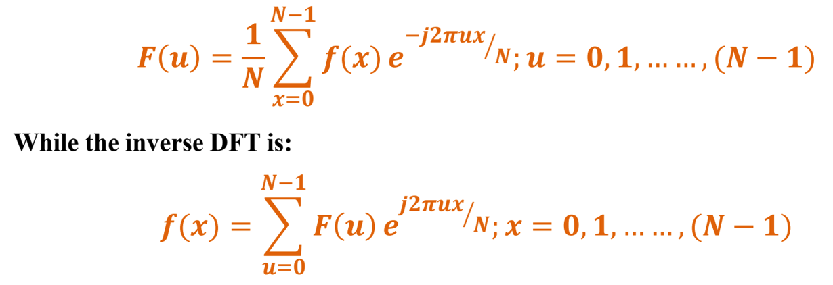
Discrete Fourier Transform Pair
F(u) and f(x) makes discrete Fourier transform pair
This means, substitution of the value of f(x) from second equation into the first equation gives identity F(u) ≡ F(u)

Slide 36
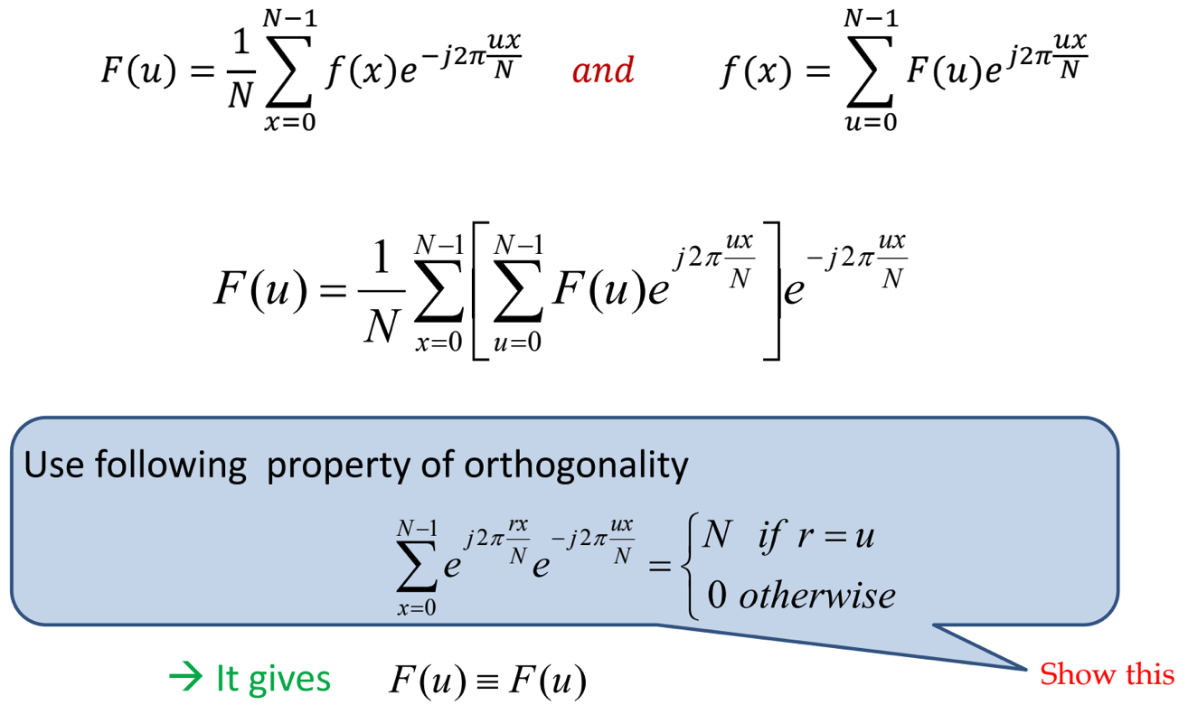
Discrete Fourier Transform Pair

Slide 37
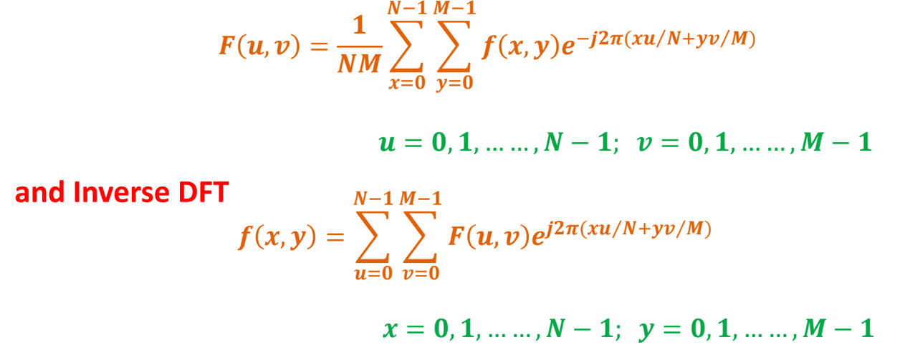
Discrete Fourier Transform: 2-D Case
The 2-D DFT works in a similar way as 1-D
For an N × M grid in x and y, we have

Slide 38
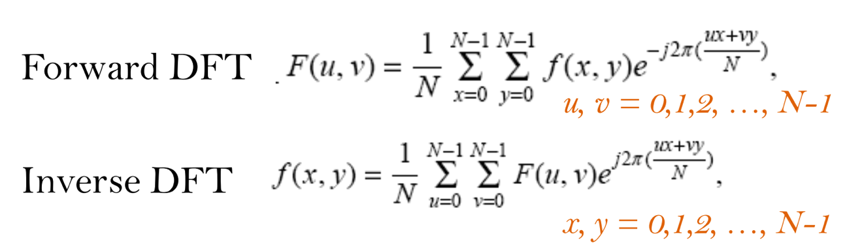
Discrete Fourier Transform: 2-D Case
When image size is N × N, this makes a special case of f(x,y)
– Use N = M to get new formulation
This makes the forward and inverse transforms look more symmetrical

Slide 39
Discrete Fourier Transform: 2-D Case
The basis functions are sine and cosine waves with increasing frequencies
F(0,0) represents the DC-component of the image which corresponds to the average brightness
F(N-1,N-1) represents the highest frequency

Slide 40
Visualization of DFT
The Fourier Transform produces a complex number valued output image which can be displayed with two images,
either with the real and imaginary part or
with magnitude and phase
In image processing, often only the magnitude of the Fourier Transform is displayed, as it contains most of the information of the geometric structure of the spatial domain image.

Slide 41
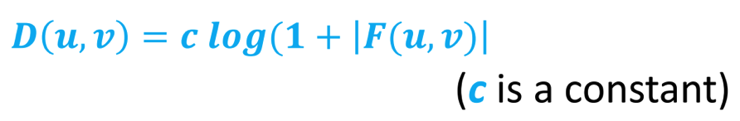
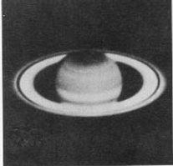
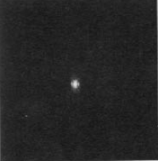
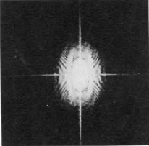
Visualization of DFT
So typically, we visualize |F(u,v)|
Since dynamic range of |F(u,v)| is normally very large, so stretching is applied
Original image DFT before scaling DFT after scaling

Slide 42
Visualization of DFT
Requirement to retransform the image from Fourier domain to spatial domain
If we want to re-transform the Fourier image correctly to spatial domain after some processing in the frequency domain, we must make sure to preserve both magnitude and phase of the Fourier image.
The Fourier domain image has a much greater range than the image in the spatial domain
Hence, to be sufficiently accurate, its values are usually calculated and stored in float values.

Slide 43
Additional Readings
Chapter 4: Image Enhancement in the Frequency Domain of the book Digital Image Processing by Rafael C. Gonzalez. and Richard E. Woods.
TheFourierTransform.com: https://www.thefouriertransform.com/
https://homepages.inf.ed.ac.uk/rbf/HIPR2/fo urier.htm

Slide 44
End

Slide 45
Fourier Transform
Part – 3

Slide 46
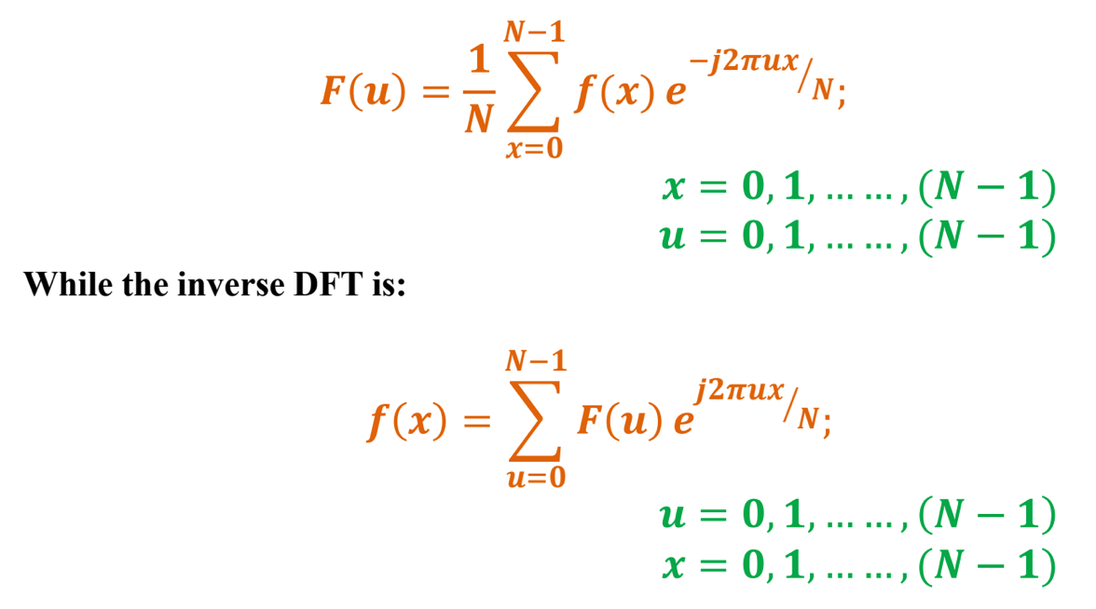
Quick Review of the Last Class
Discrete Fourier Transform: 1-D

Slide 47
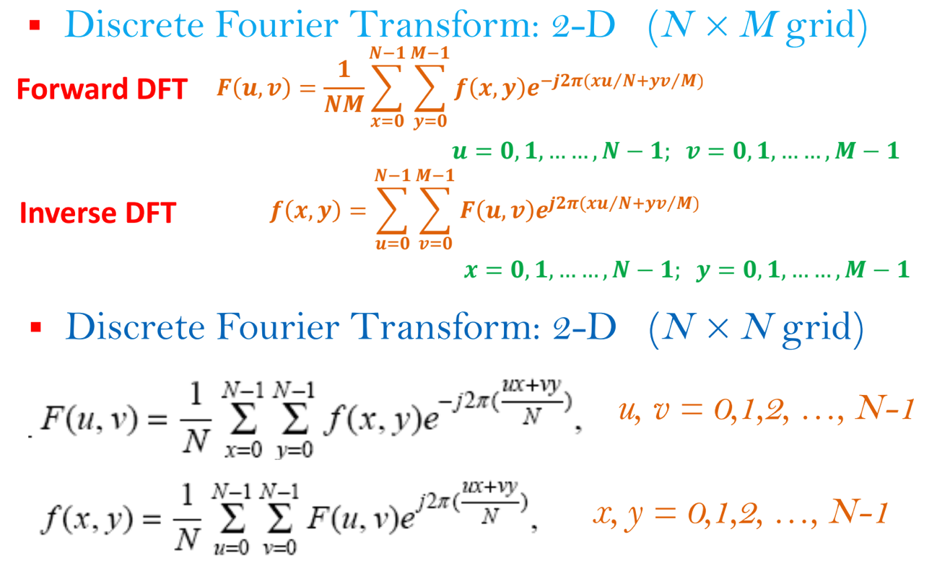
Quick Review of the Last Class…contd

Slide 48
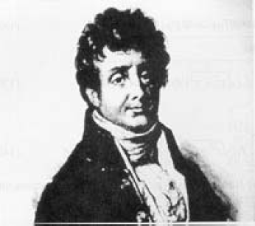
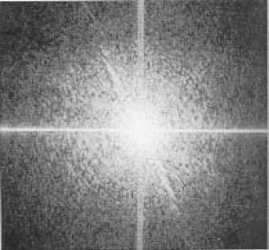
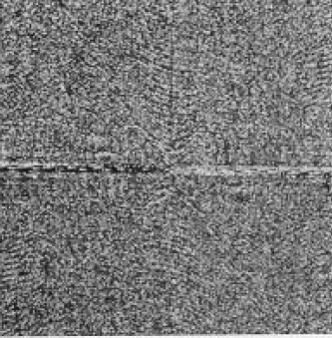
Quick Review of the Last Class…contd
Fourier transform image
spectrum (Magnitude )
is always symmetrical about the center.
– For every point on one side of the magnitude spectrum image, we shall always get a similar ‘point’ mirrored across the center of the image.
N x M Image
N x M DFT Image (Magnitude)
N x M DFT Image (Phase)
Original Image and corresponding DFT image

Slide 49
Quick Review of the Last Class…contd
The same thing happens with the 'phase' component of FT image pair
– However, in this case with a 180 degree shift (a negative phase) in value as well.
N x M Image
N x M DFT Image (Magnitude)
N x M DFT Image (Phase)
Original Image and corresponding DFT image

Slide 50
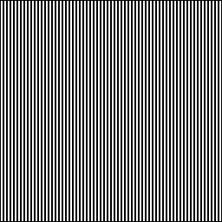

Examples of 2D DFT
Shows 2 pixel wide vertical stripes
Fourier transform
Example Source: http://homepages.inf.ed.ac.uk/rbf/HIPR2/fourier.htm

Slide 51
Examples of 2D DFT
If we check carefully, we see that the Fourier transform in the previous slide contains 3 main values:
the DC-value and
since the Fourier image is symmetrical to its center, two points corresponding to the frequency of the stripes in the original image
Note that the two points lie on a horizontal line through the image center
– This is because the image intensity in the spatial domain changes the most if we go along it horizontally

Slide 52
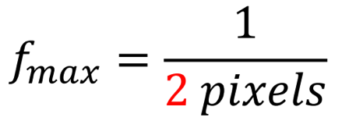
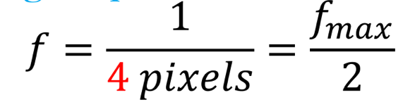
Examples of 2D DFT
The distance of the points to the center can be explained as follows:
The maximum frequency which can be represented in the spatial domain comes from two pixel wide stripe pairs (one white, one black).
Hence, the two pixel wide stripes in this example image represent

Slide 53
Examples of 2D DFT
Thus, the points in the Fourier image are halfway between the center and the edge of the image
– i.e. the represented frequency is half of the maximum.
Further investigation shows that the magnitude of other frequencies in the image is less than 1/100 of the DC-value, i.e. they don't make any significant contribution to the image.
The magnitudes of the two minor points are each two-thirds of the DC-value.

Slide 54

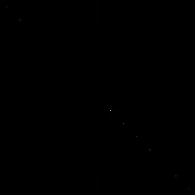
Examples of 2D DFT
Similar effects (as in the previous example) can be seen when applying the Fourier Transform to following image
Shows 2 pixel wide slanted stripes
Fourier transform

Slide 55
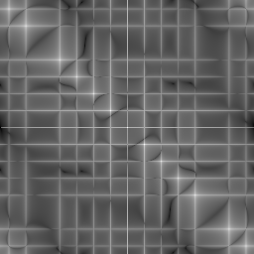
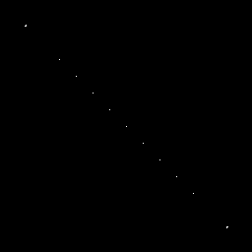
Examples of 2D DFT
In the previous slide, in Fourier Transform (magnitude spectrum), we see that, again, the main components of the transformed image are the DC-value and the two points corresponding to the frequency of the stripes.
Now take the log of the transform (magnitude spectrum)
logarithmic transform of the Fourier Transform
Thresholded image (Th=13) for the image on left

Slide 56
Examples of 2D DFT
However, the logarithmic transform of the Fourier transform shows that now the image contains many minor frequencies.
– The main reason is that a diagonal can only be approximated by the square pixels of the image, hence, additional frequencies are needed to compose the image.
The logarithmic scaling makes it difficult to tell the influence of single frequencies in the original image.
– To find the most important frequencies we threshold the original Fourier magnitude image at level 13.

Slide 57
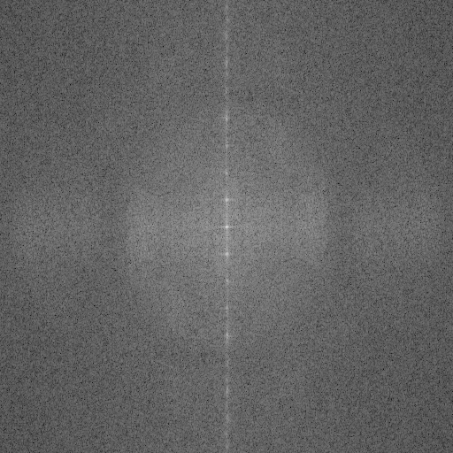
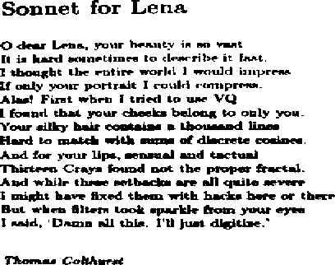
Examples of 2D DFT
A binary image of English text image
the logarithm of the magnitude of its Fourier transform

Slide 58
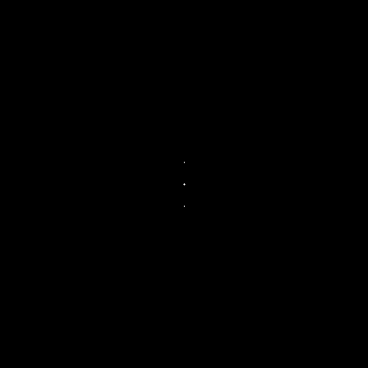
Examples of 2D DFT
The logarithm of the magnitude of its Fourier transform
Thresholded magnitude of the Fourier image.
We can see that the main values lie on a vertical line, indicating that the text lines in the input image are horizontal.

Slide 59

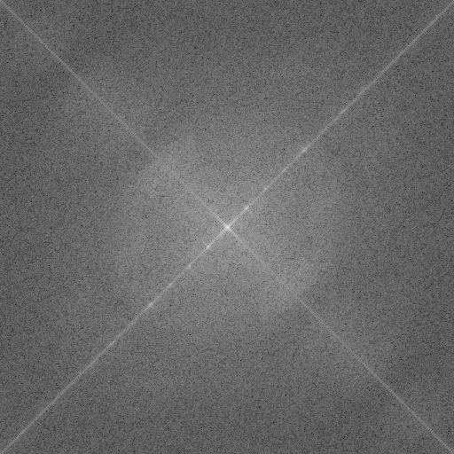
Examples of 2D DFT
Image rotated about 45° Fourier transform
We can see that the line of the main peaks in the Fourier domain is rotated according to rotation of the input image.
The second line in the logarithmic image (perpendicular to the main direction) originates from the black corners in the rotated image.

Slide 60
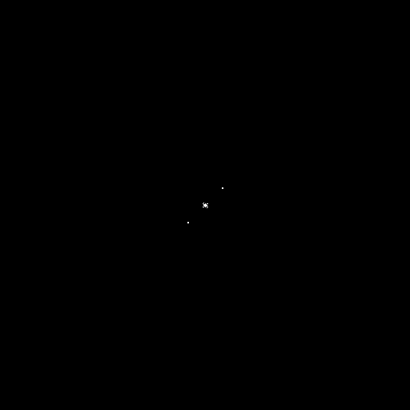
Examples of 2D DFT
Fourier transform
Thresholded image of Fourier transform
We can see that the line of the main peaks in the Fourier domain is rotated according to rotation of the input image.
The second line in the logarithmic image (perpendicular to the main direction) originates from the black corners in the rotated image.

Slide 61
2D DFT – Points to note
Half of each image is a duplicate of the other half
– Both the halves have exactly the same amount of information)
However, we need BOTH images to recreate the original image.
Both the halves together produce whole image.

Slide 62
Fast Fourier transform (FFT)
In case of fast Fourier transform (FFT)
It only generates the left half the images.
The other half is generated by rotations and duplication of the generated data.
When converting Frequency Domain images back to a Spatial Domain Image
the algorithm again only looks at the left half of the image.
The right half is completely ignored, as it is only a duplicate.

Slide 63
Magnitude and Phase of DFT
What is more important (Magnitude and Phase) ?
magnitude
phase
Hint:
– use inverse DFT to reconstruct the image using magnitude or phase only information and check

Slide 64
Magnitude and Phase of DFT
Magnitude determines the relative presence of a sinusoid in the original function f(x, y)
Phase determines the relative phases (placement) of the sine and cosine waves
– (i.e., how they line up with respect to one another) to form original signal f(x, y)

Slide 65
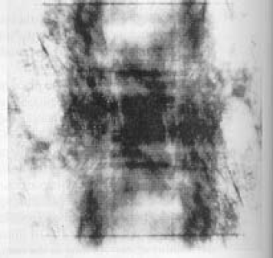
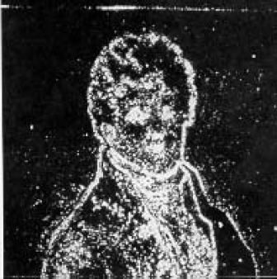
Magnitude and Phase of DFT
Reconstructed image using magnitude only
(i.e., magnitude determines the contribution of each component!)
Reconstructed image using phase only
(i.e., phase determines which components are present!)

Slide 66
Magnitude and Phase of DFT
Which is more important for a given signal?
Answer: Phase
Does one component (magnitude or phase) contain more information than another?
Yes, typically phase
When filtering, if we have to preserve one component (magnitude or phase) more, which one would it be?
It is important to preserve phase during filtering

Slide 67
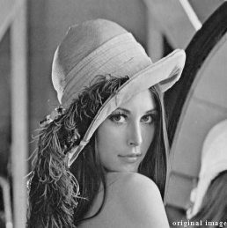
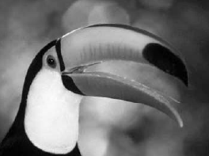

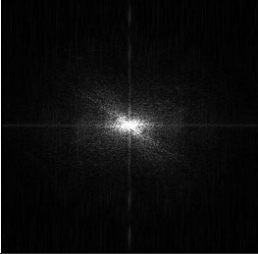
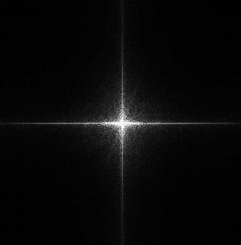

2-D DFT Examples of Few Natural Images

Slide 68
End

Slide 69
Fourier Transform
Part – 4

Slide 70
Agenda for Today’s Class
Computational Complexity of FT
1D
2D
Filtering in frequency (Fourier) domain
Properties of DFT

Slide 71

Computational Complexity of 1-D Fourier Transform (1)

Slide 72

Computational Complexity of 1-D Fourier Transform (2)
The direct implementation of the DFT using above equation requires O(N²) operations.
– complexity O(N²)
Using the FFT this is reduced to O(N log(N)).

Slide 73


Computational Complexity of 2-D Fourier Transform (1)
Forward DFT:
u, v = 0,1,2, …, N-1
Inverse DFT:
x, y = 0,1,2, …, N-1
Complexity: O(N⁴)

Slide 74

Computational Complexity of 2-D Fourier Transform (2)
Reduction using DFT Property of Separability
The 2-D DFT can be computed using 1-D transforms only:
Forward DFT: Inverse DFT:
Kernel is separable:
− j 2π ( ^{ux+vy} )
− j 2π ( ^{ux} )
− j 2π ( ^{vy} )
e
N
=e
N
e
N

Slide 75




Computational Complexity of 2-D Fourier Transform (3)
Reduction using DFT Property of Separability
Rewrite F(u,v) as follows:
Let’s set:
Then:

Slide 76

Computational Complexity of 2-D Fourier Transform (4)
Reduction using DFT Property of Separability
How can we compute F(x, v)?
)
N x DFT of rows of
f(x, y)
How can we compute F(u, v)?
DFT of columns of F(x, v)

Slide 77



Computational Complexity of 2-D Fourier Transform (5)
Reduction using DFT Property of Separability
(𝟎, 𝟎) (𝑵 − 𝟏) _{𝒚}
(𝟎, 𝟎) (𝑵 − 𝟏) _{𝒗}
(𝟎, 𝟎) (𝑵 − 𝟏) _{𝒗}
𝒇(𝒙, 𝒚)
𝑭(𝒙, 𝒗)
𝑭(𝒖, 𝒗)
Row transforms
Column
Multiplication by 𝑵
Transforms
(𝑵 − 𝟏)
(𝑵 − 𝟏)
(𝑵−𝟏)
𝒙
𝒙
𝒖

Slide 78
Computational Complexity of 2-D Fourier Transform (6)
Reduction using DFT Property of Separability
Using these two formulae, the spatial domain image is first transformed into an intermediate image using N one-dimensional Fourier Transforms.
This intermediate image is then transformed into the final image, again using N one-dimensional Fourier Transforms.
Expressing the two-dimensional Fourier Transform in terms of a series of 2N one-dimensional transforms decreases the number of required computations.

Slide 79
Computational Complexity of 2-D Fourier Transform (7)
Reduction using DFT Property of Separability
Ordinary one-dimensional DFT has O(N²) complexity.
Even with these computational savings,
– Complexity of 2-D DFT: O(N³)

Slide 80
Computational Complexity of 2-D Fourier Transform (8)
Reduction using Fast Fourier Transform
Complexity of computation of 1-D DFT can be reduced to N log₂ N if we employ the Fast Fourier Transform (FFT)
So overall complexity:
– O(N²log₂ N)
This is a significant improvement, in particular for large images.
There are various forms of the FFT and most of them restrict the size of the input image that may be transformed, often to N = 2^{n} where n is an integer.

Slide 81





Performing filtering in Frequency Domain
For low-pass filtering, the transfer function is:
Input image)
Fourier Transform
For high-pass filtering, the transfer function is:
Low-pass filter ^{Low-pass filter} (perspective plot) ^{displayed as an image)}
Low-pass filter (radial cross section)
Image source: Rafael C. Gonzalez, Richard E. Woods Digital Image Processing, 2nd edition, Pearson Education, ISBN: 81-7808-629-8

Slide 82


Performing filtering in Frequency Domain
For band-pass filtering, the transfer function is:
For band-stop filtering, the transfer function is:

Slide 83

Properties of DFT
Periodicity:
– The DFT and its inverse are periodic with period N
Image source: Rafael C. Gonzalez, Richard E. Woods Digital Image Processing, 2nd edition, Pearson Education, ISBN: 81-7808-629-8

Slide 84


Properties of DFT
Conjugate Symmetry:
– If f(x, y) is real, then
f(x, y) is even if f(x, y) = f(-x,-y)
f(x, y) is odd if f(x, y) = -f(-x,-y)
A function can be neither even nor odd

Slide 85

Properties of DFT
Theorem: The Fourier transform of a real even function is real
s is frequency here & t is distance
Theorem used: The integral of the product of odd and even functions is zero.

Slide 86

Properties of DFT
Theorem: The Fourier transform of a real odd function is imaginary.
s is frequency here
& t is distance
Theorem used: The integral of the product of odd and even functions is zero.

Slide 87
End

Slide 88
Fourier Transform
Part – 5
Properties of Fourier Transform

Slide 89
Quick Review of the Last Class
Computational Complexity of DFTs – 1D & 2D
Filtering in Frequency Domain
Properties of Fourier Transform
Periodicity
F(u, v) = F(u + N, v) = F(u, v + N)=F(u + N, v + N)
Conjugate symmetry
If f(x, y) is real then F(u, v) = F*(-u, -v) => |F(u, v)| = |F*(-u, -v)|
The Fourier transform of a real even function is real
The Fourier transform of a real odd function is imaginary

Slide 90
Agenda for Today’s Class
Properties of Fourier Transform (...continued)
Scaling
Distribution [Addition/Multiplication]
Derivative and Laplacian
Translation in spatial domain
Translation in frequency domain
Rotation in spatial domain

Slide 91
Properties of Fourier Transform
Scaling
For two scalars a and b
af (x, y) ⇔ aF (u, v)
f (ax, by) ⇔ ¹ F (u / a, v / b)
ab
For example, scaling of the image

Slide 92
Properties of Fourier Transform
Distribution [Addition/Multiplication]
But for product, following is not true in general …

Slide 93
Properties of Fourier Transform
Derivative
𝑑^{𝑛}𝑓(𝑥)
𝑛
𝐹
2𝜋𝑗u 𝐹(u)
𝑑𝑥^{𝑛}
Laplacian
2 2
₌ 𝜕 𝑓 ₊ 𝜕 𝑓
𝛻²𝑓 𝑥,𝑦
𝜕𝑥² 𝜕𝑦²
−(2𝜋)² u²+ 𝑣²
𝐹 𝛻²𝑓(𝑥, 𝑦)
𝐹(u, 𝑣)

Slide 94

Properties of Fourier Transform
Translation in spatial domain:

Slide 95


Properties of Fourier Transform
Translation
– to show a full period, we need to translate the origin of the transform at u=N/2 (or at (N/2,N/2) in 2D)
||F_{F}(u_{(u})|_{)|}
||F_{F}(u_{(u}-N_{-N}/2/)|_{2)|}
Image source: Rafael C. Gonzalez and Richard E. Woods Digital Image Processing, 3rd edition, Pearson Education, ISBN: 978-81-317-2695-2

Slide 96

Properties of Fourier Transform
Translation:
– To move F(u, v) at (N/2, N/2), take u₀ = v₀ = N/2
Using

Slide 97

Properties of Fourier Transform
Translation:
𝒇 𝒙, 𝒚 (−𝟏)^{𝒙+𝒚}
↔ 𝑭(𝒖 − 𝑵/2, 𝒗 − 𝑵/2)
no translation
after translation

Slide 98

Properties of Fourier Transform – Translation

Slide 99

Properties of Fourier Transform
Rotation

Slide 100




Properties of Fourier Transform
Rotation
– Rotating f(x, y) by θ rotates F(u, v) by θ

Slide 101

Properties of Fourier Transform
Average Value

Slide 102
End

Slide 103

Appendix: Theorem Proof
Theorem: The integral of the product of odd and even functions is zero. [f_{e}(x):even, f_{o}(x): odd]

Slide 104

Theorem Proof

Slide 105

Theorem Proof
Hence, the integral of the product of odd and even functions is zero.

